Slide 1


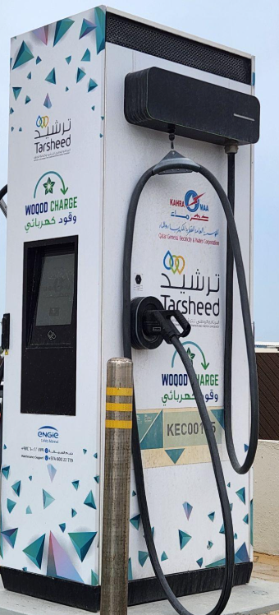
SCARCITY OF EV STATIONS IN QATAR
Presented by: Kholoud Darwish, Yousif Ahmed, AlAnoud AlKubaisi, Faisal AlBustami
1

Slide 2
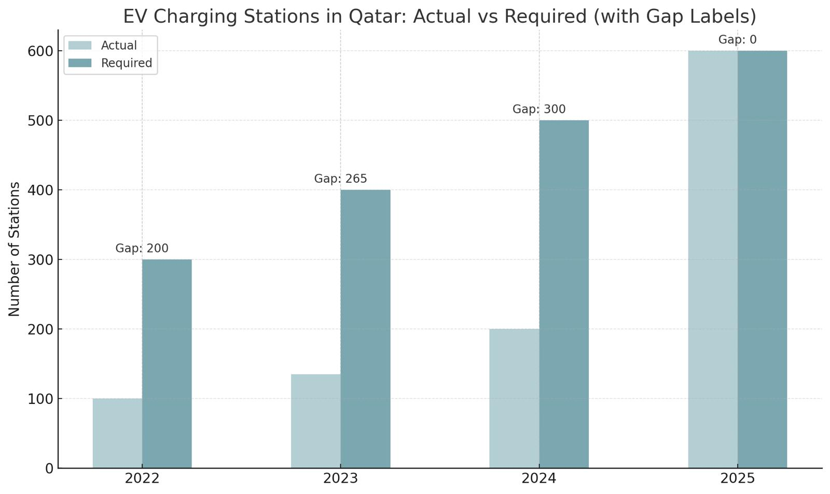
SCARCITY OF EV STATIONS IN QATAR
PROBLEM STATEMENT
THE PROBLEM
EV adoption outpaces charging usage.
KAHRAMAA recommended the need for scalable solutions.
Impacts EV users, disrupts grid stability.
Slows QNV 2030 sustainability goals.
WHY IT MATTERS
Energy shortages could happen.
Slows EV growth.
Grid under pressure.
Needs quick planning.
The Peninsula. (2024, January 14). KAHRAMAA sets up 200 EV charging stations.
https://thepeninsulaqatar.com/article/14/01/2024/kahramaa-sets-up-200-ev-charging-stations
Gulf Times. (2023, January 10). KAHRAMAA to set up 150 electric charging stations in 2023. https://www.gulf-times.com/article/653048/qatar/kahramaa-to-set-up-150-electric-charging-stations-in-2023
2

Slide 3
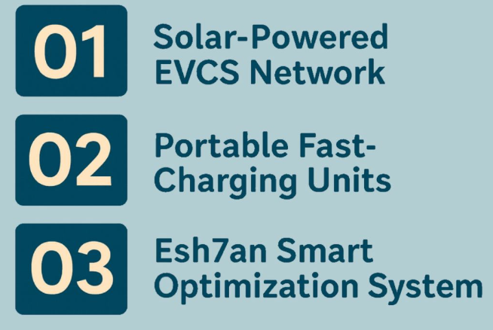
OUR PROPOSED SOLUTIONS
3

Slide 4
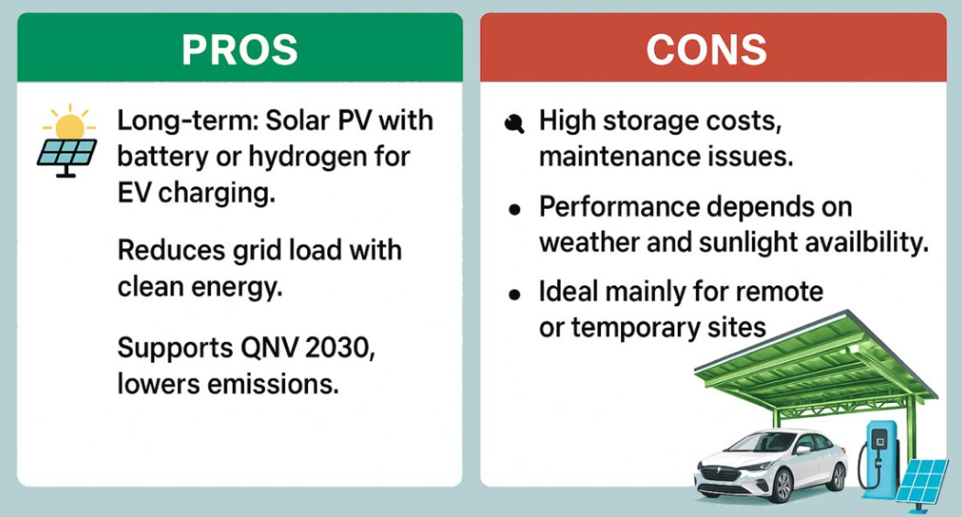
SOLUTION 1: SOLAR-POWERED EVCS NETWORK
Al Wahedi, A., & Bicer, Y. (2020). A Case Study in Qatar for Optimal Energy Management of an Autonomous Electric Vehicle Fast Charging Station with Multiple Renewable Energy and Storage Systems. Energies, 13(19), 5095. https://doi.org/10.3390/en13195095
4

Slide 5
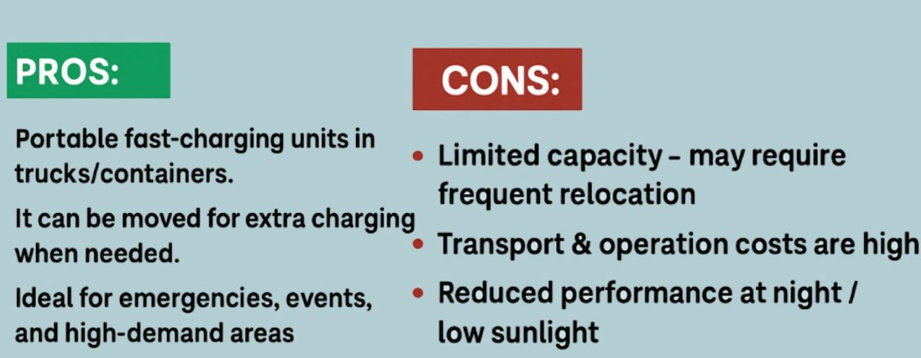


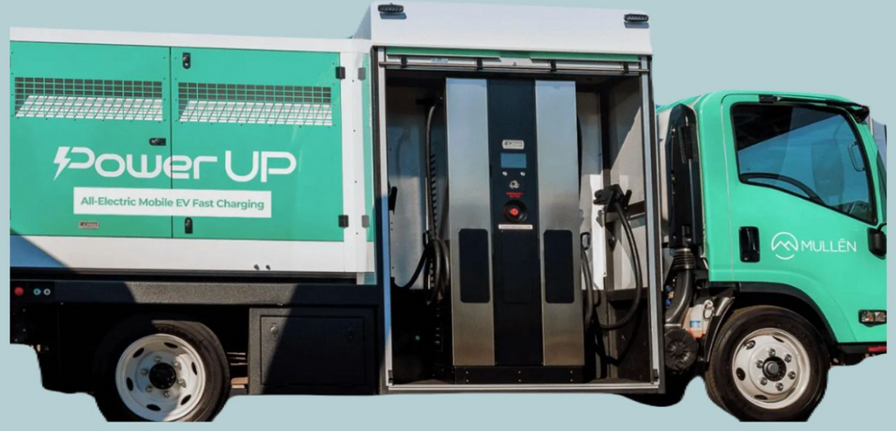

SOLUTION 2: PORTABLE FAST-CHARGING UNITS
Weather sensitivity: Harsh weather can affect performance and reliability.
5
Luobinsen Global. (2024). Portable EV Charger Product Page. Retrieved from https://www.luobinsen-global.com/product/portable-charger/

Slide 6
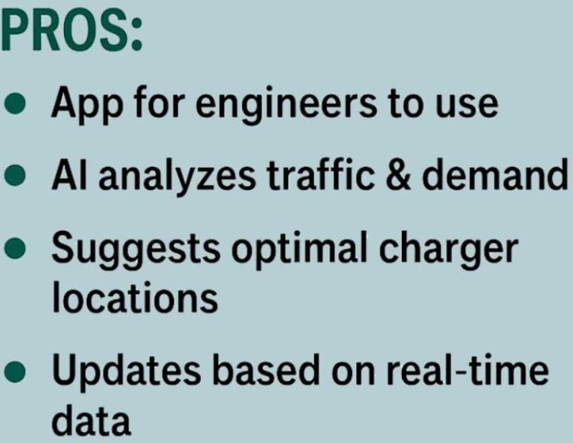
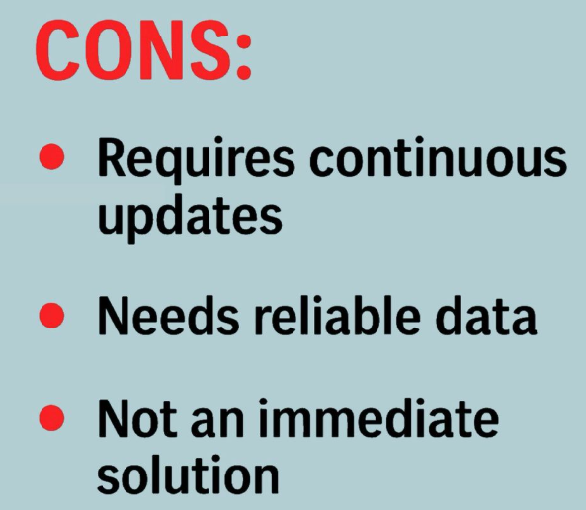
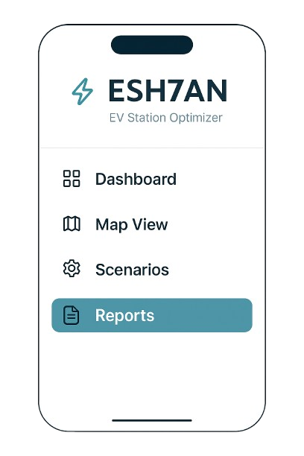


SOLUTION 3: ESH7AN - SMART OPTIMIZATION SYSTEM
Deshmukh, S., Tariq, H., Amir, M., Iqbal, A., Marzband, M., & Al-Wahedi, A. M. A. B. (2024). Impact Assessment of Electric Vehicle Integration and Optimal Charging Schemes Under Uncertainty: A Case Study of Qatar. IEEE Access, 12, 131350–131371. https://doi.org/10.1109/ACCESS.2024.3458410
6

Slide 7
DECISION MATRIX
Solution | Human Development | Social Development | Economic Development | Environmental Development | Total
Esh7an | 5 | 9 | 8 | 9 | 31
Portable Units | 6 | 8 | 7 | 7 | 28
Solar EV Network | 5 | 7 | 8 | 6 | 26
7

Slide 8
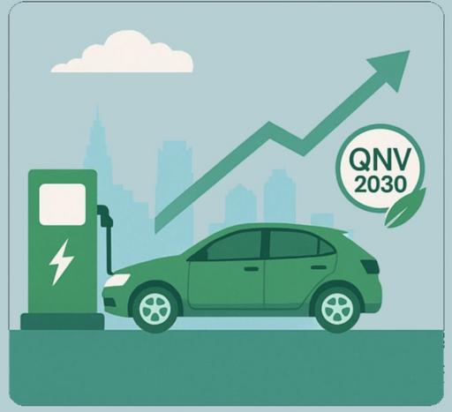
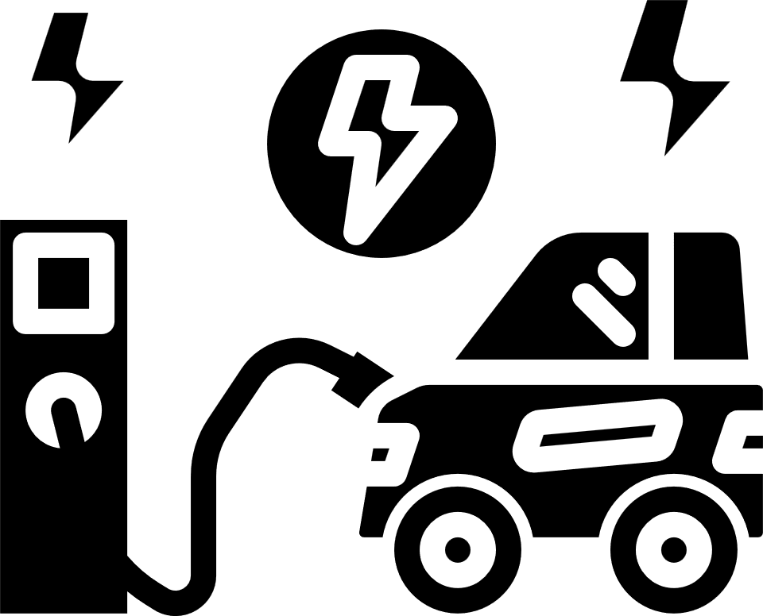
CONCLUSION
Esh7an is the main solution for scalable charging and smart planning (as per KAHRAMAA’s feedback).
Portable chargers and solar stations support the network where needed.
These solutions align with QNV 2030 for cleaner transportation.
8

Slide 9
THANK YOU FOR YOUR ATTENTION
9

